Slide 1
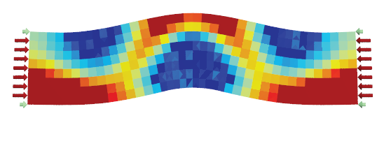
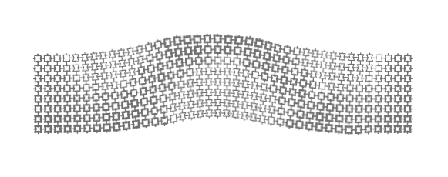
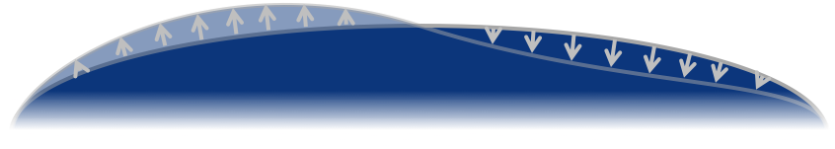
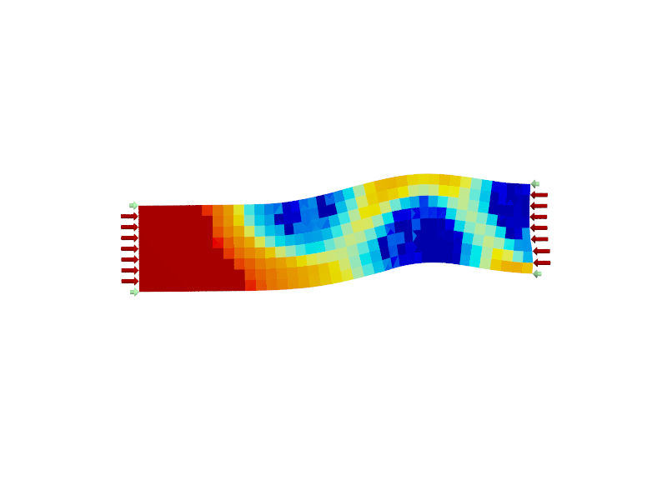
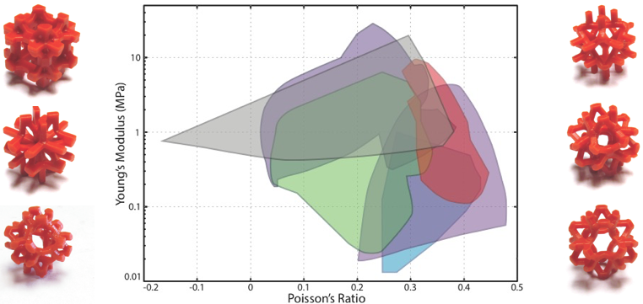
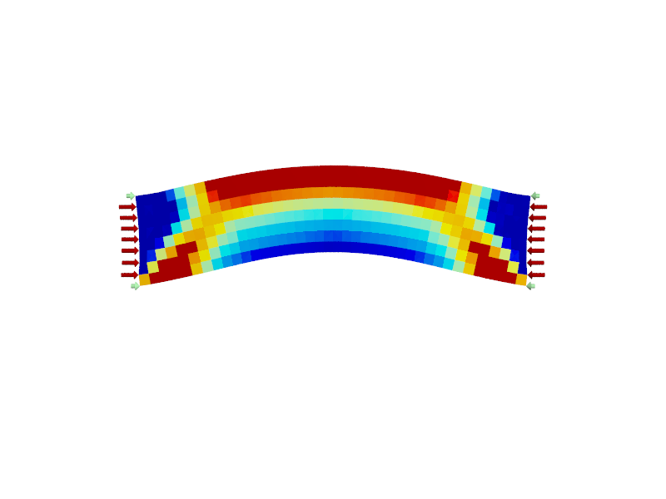
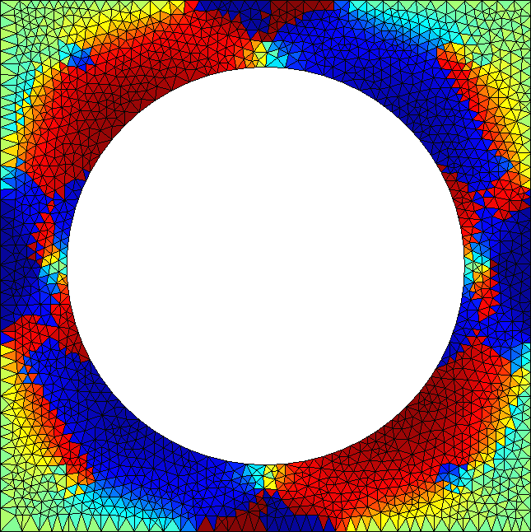
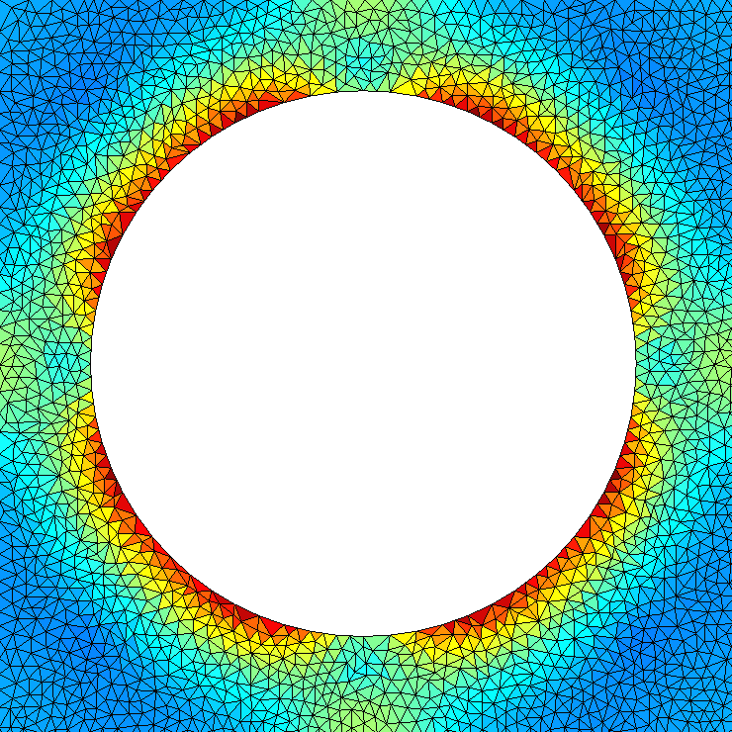
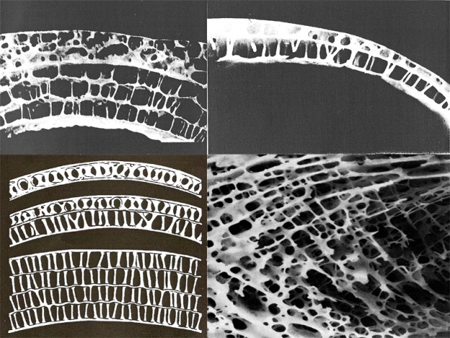
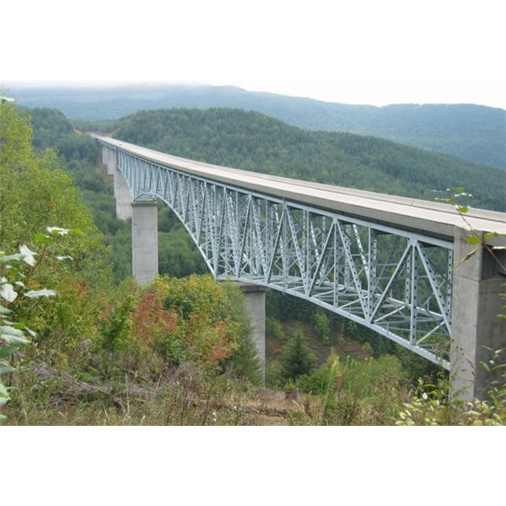
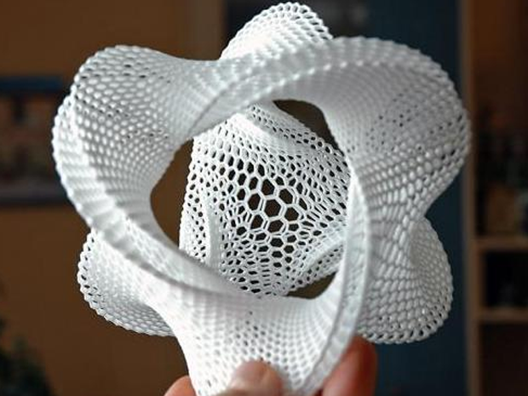
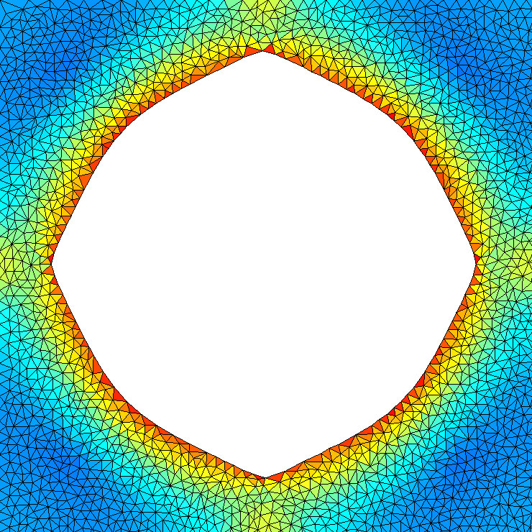
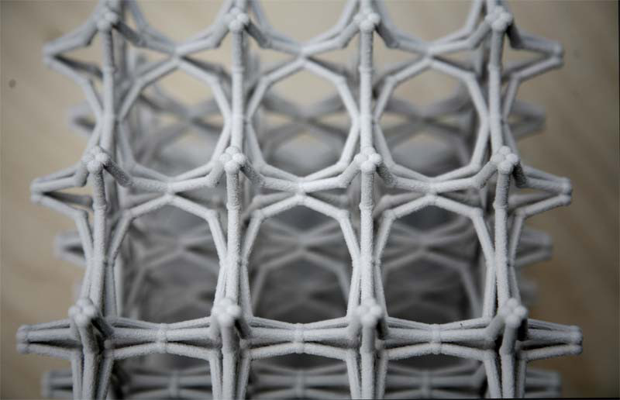
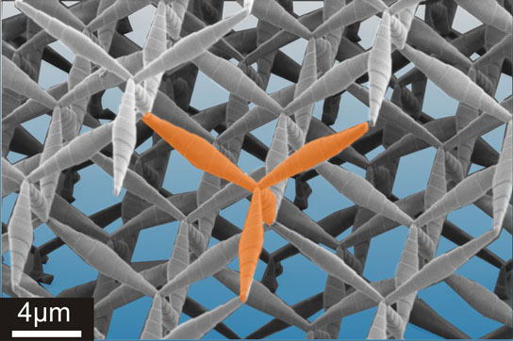


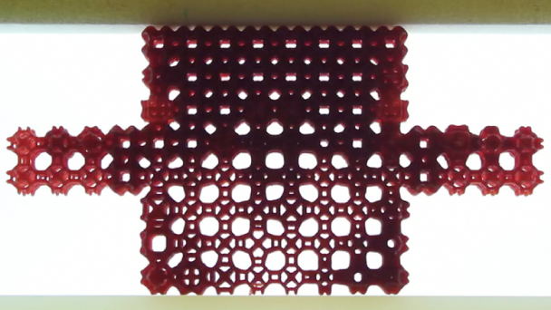
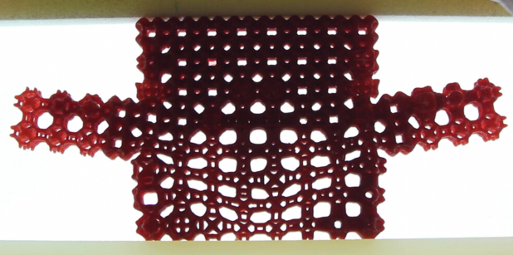
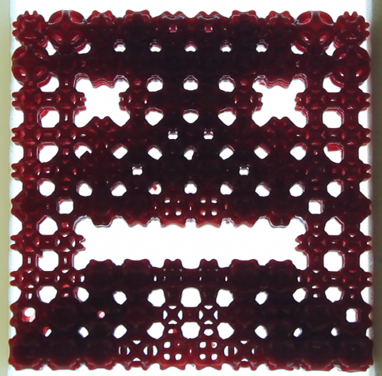
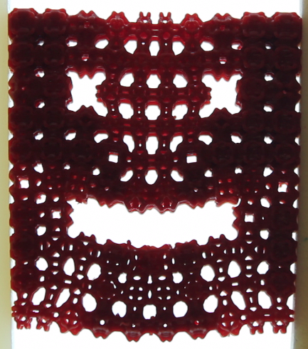
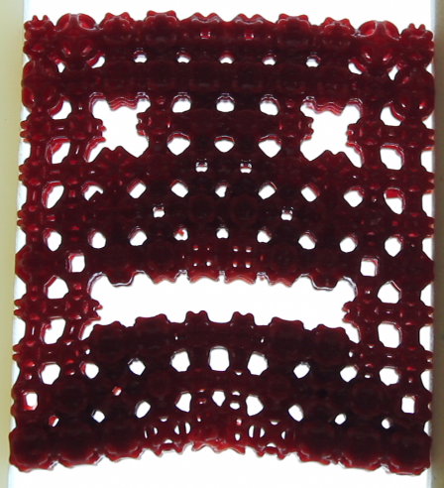
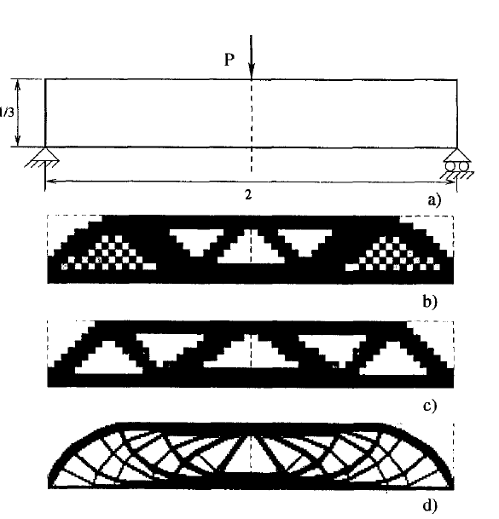
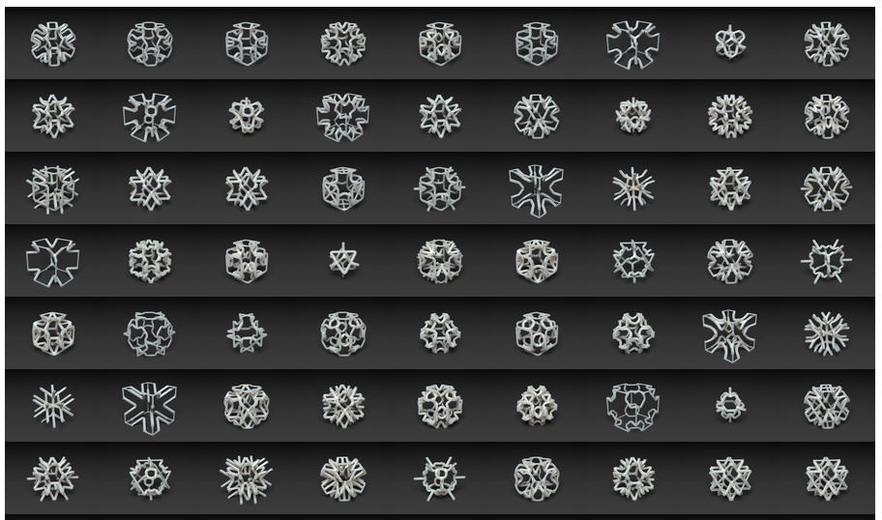
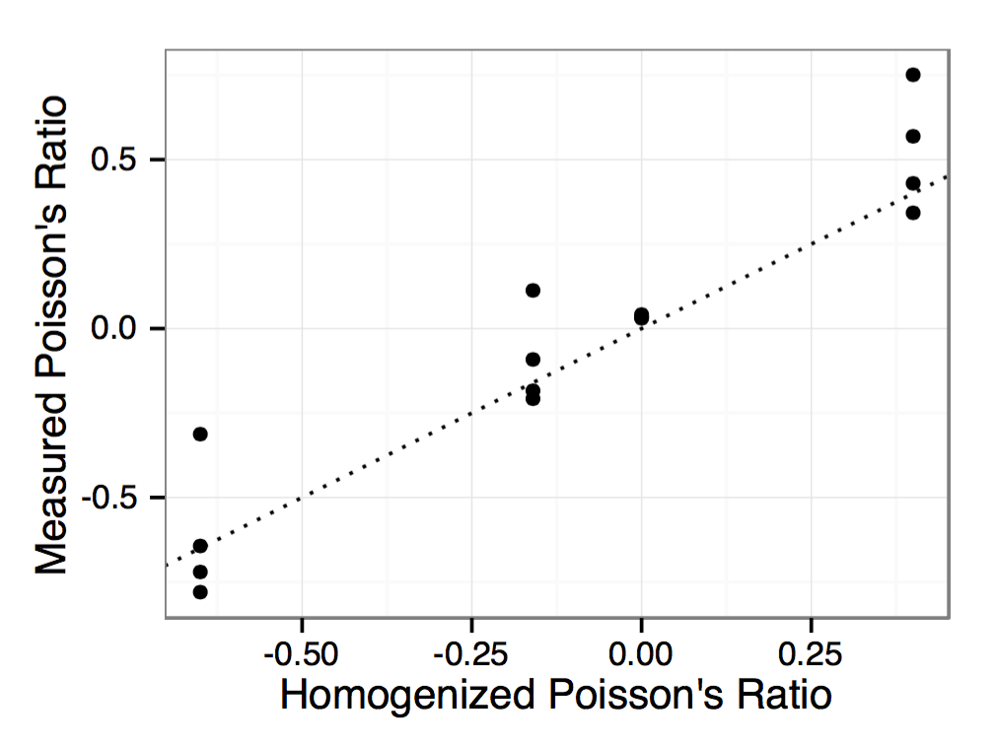
Adaptive Fine-Scale Structure Design: From Theory to Fabrication
PIs: R. V. Kohn, J. L. Ricci, Y. Zhang, D. Zorin. PhD students: J. Panetta, Q. Zhou
Courant Institute and School of Dentistry, New York University
SUMMARY
STRUCTURE OPTIMIZATION BY HOMOGENIZATION
SHAPE OPTIMIZATION
ONGOING WORK
Motivation
Additive fabrication technologies enable fabrication of customized, spatially varying microstructures.
Such structure effectively allows continuous variation of homogenized material properties, in departure from standard approaches to structural design.
The potential of combining macro- and micro-scale design is considerable and offers many new possibilities: for example, manufacturing negative-Poisson’s-ratio and pentamodal fluid-like materials, adapting to complex surface shapes.
Goals
Build a bridge between advanced mathematical theory of microstructures, practical computational techniques, and experiment.
Design parametric families of microstructures, validated with computation, fabrication and experiment.
Develop techniques for using these to solve specific shape optimization problems.
Explore its applications in a concurrent project on bone scaffolding design.
Observation 1: when the structure becomes very fine, it is equivalent to a homogeneous material.
Observation 2: variable structure = variable material properties.
Approach
Partition a shape into small cells.
Design with per-cell material properties as variables.
Create a map from material properties to fine structure.
Convert material properties to structure for each cell.
For pattern topology, we optimize the shape parameters (thicknesses, offsets) to achieve a wide range of isotropic material properties.
We run a nonlinear least squares optimization to fit a pattern’s homogenized tensor, , to each target isotropic tensor, :
We use a shape derivative to determine how perturbations of the shape, , change . Then, chain rule gives the fitting energy’s gradient with respect to the thicknesses and offsets.
Move beyond regular, axis-aligned grids for cell layouts
Adapt to curvilinear macroscopic geometry
Permit length scale to vary spatially (e.g., allowing larger pores deep inside the object)
Initial approach: use a mostly regular quadrilateral (2D) or hexahedral (3D) mesh adapting to the object’s boundary.
Avoid brittle fracture and plastic deformation
Ensure microscopic stress under worst-case load lies pointwise within an appropriate set of “safe stresses.”
The periodic homogenization formulas show how to compute at each point the microscopic stress corresponding to a particular macroscopic stress (load).
We define the worst-case macroscopic stress for a point in the microstructure as the maximizer over unit-norm macroscopic stresses of (some norm of) the corresponding microscopic stress tensor (e.g. max norm for fracture avoidance, von Mises stress for plastic deformation).
These maximizations reduce to a tensor eigenvalue problem that can be solved efficiently at each point of the structure:
These pointwise worst-case stress measures can also be shape-differentiated, enabling optimization (here, with volume held constant) :
MATERIAL OPTIMIZATION
RESULTS: 3D ISOTROPIC PATTERNS
Example problem
Given loads and target surface displacements, find material distribution achieving these displacements.
PDE-constrained optimization, nonlinear, but well-behaved.
Strain fitting: minimize with fixed Dirichlet and Neumann solutions for initial C(p), then resolve:
We show the space of isotropic materials reached by the six topologies in the single family with greatest coverage:
COMPLEX STRUCTURES
Young’s modulus distributions for
same loads, different target
displacements.
Bone structures Bridge truss structure 3D-printed fine-scale structure
Exotic materials
HOMOGENIZATION
Young’s moduli range from under 1/14,000 up to over 1/10 of the bulk material’s Young’s modulus.
Poisson’s ratios span from -0.16 to nearly 0.5 (theoretical limit)
Worst-case load (macro stress)
Visualizing component 1.
Corresponding worst-case micro stress
Visualizing Frobenius norm.
Goal: extract material properties from periodic microstructure.
We solve for effective elasticity tensor as the scale goes to zero.
We solve 6 problems, for different basis strains :
EXAMPLES
Flapping: squeeze top and bottom, goal is to make wings go up.
Material Optimization Results
Initial worst-case micro stress
Minimized worst-case micro stress
Young’s Modulus
Poisson’s Ratio
FUTURE GOALS
PATTERN ISOTROPY
Fabricating these material fields using our cell structures achieves the target deformation:
Bone scaffolds
Dental school group was producing bone scaffold prototypes from biphasic calcium phosphate, using "robocasting" technology; Courant group has developed and tested design techniques for stereolithography. A crucial goal is integration.
Differences in functionality: while bone scaffolds need to support appropriate loads, their non-mechanical properties (such as the pore size) are also crucial.
Differences in manufacturing technology: "robocasting” is based on extrusion and deposition of colloidal gel inks as continuous filaments, and requires different manufacturability constraints
Fundamentals
A major long-term goal is to consider a variety of models of material behavior and classes of structures.
If the macroscopic stress and strain vary significantly between different parts of a structure, then it is natural to consider designs whose local topology is nonuniform. How can the topology be changed while maintaining desirable mechanical properties?
Our recent focus on network-like structures explores just one of many approaches to the design of microstructure; other classes of structures may offer different opportunities. For example: In 3D, porous structures can be made using walls rather than struts; are such structures manufacturable, and might they offer some practical advantages?
Auxetic
Negative Poisson’s ratio
Fris, Lakes and Parks (1988)
Image: Norbert Palz
Pentamodal
Proposed: Milton and Cherkaev (1995)
Fabricated: Kadic et al. Karlsruche (2012) using Dip-in Direct-Laser-Writing Optical Lithography
Our main goal is to design structures with isotropic properties.
Cubic symmetry (square in 2D) ensures an orthotropic homogenized material, but isotropy is challenging.
We validated our structures’ isotropy both numerically and experimentally (compressing a fabricated structure that was rotated by 45° and clipped to a box).
Faces: different structures cause the face to smile or frown
TOPOLOGICAL STRUCTURE OPTIMIZATION
PATTERN FAMILIES
or
Sigmund and Petersson, 1998
Resolution- and regularization-dependent
Spurious checkerboard solution
Coarse discretization
Fine discretization
We consider truss-like structures defined by bar connectivity (topology) and bar thickness/node offset parameters.
Easy to formulate printability constraints (e.g., min thickness) and ”stitch together” neighboring cells with different patterns.
One topology is not enough to cover the full range of material properties; we run a combinatorial exploration of topologies:
FABRICATION AND TESTING
We fabricated tilings of 5mm cells on a stereolithography printer (B9Creator) with 30 micron resolution and 200 micron min feature size.
Compression testing showed patterns behaved nearly linearly for small deformations and had stiffness consistent with their target Young’s moduli.
Our lower-accuracy Poisson’s ratio testing setup also gave consistent measurements.
Topological optimization removes and adds material based on topological derivatives (effect of introducing a void on objective).
It requires regularization to avoid spurious solutions, working with very high resolutions difficult.
Symmetry and simplicity constraints reduce this space to 1205 patterns.
We divide these topologies into 138 families that can be used together in a single design (matching interface topology).

